Slide 1
Georges Seurat
Born in Paris, France in 1891
Invented Pointilism – a new way to paint without mixing colors!
He was a scientist and artist. He loved to study colors and optical illusions
He mostly made landscape paintings, and they would take years to finish!

Slide 2
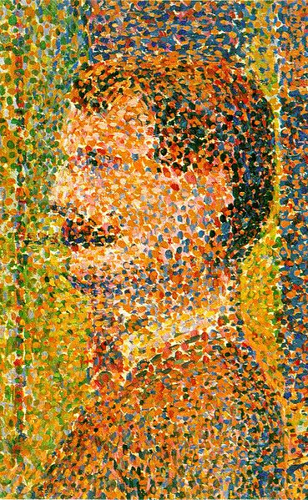
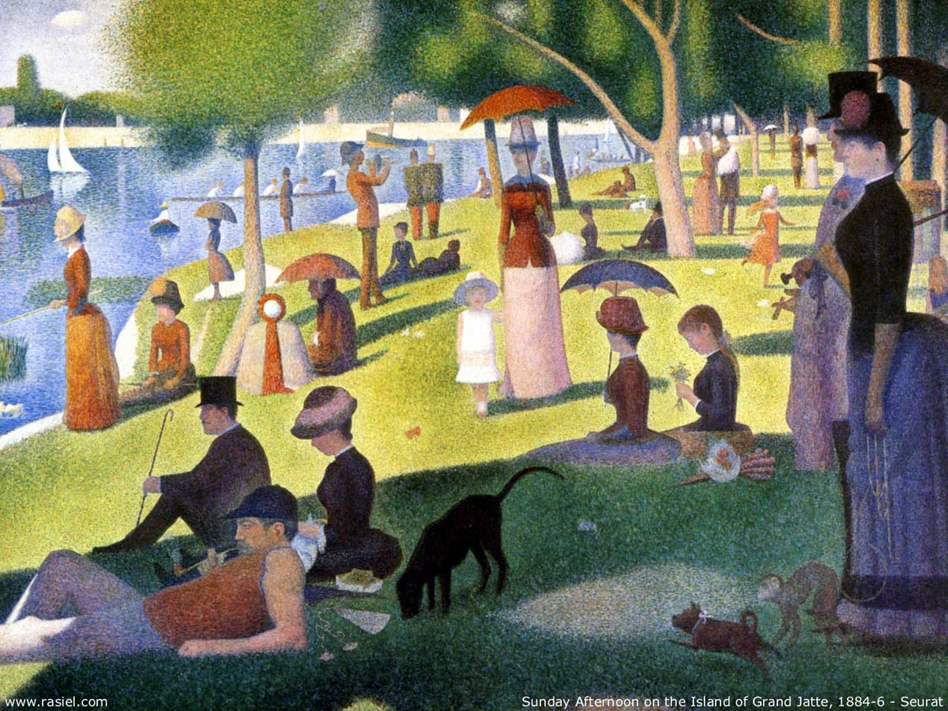
Seurat “the Dot” made HUGE paintings made of many tiny dots of paint

Slide 3
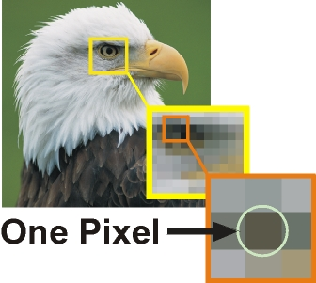
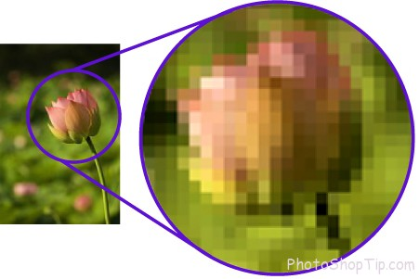
Your eyes mix together the colors like PIXELS on a screen

Slide 4
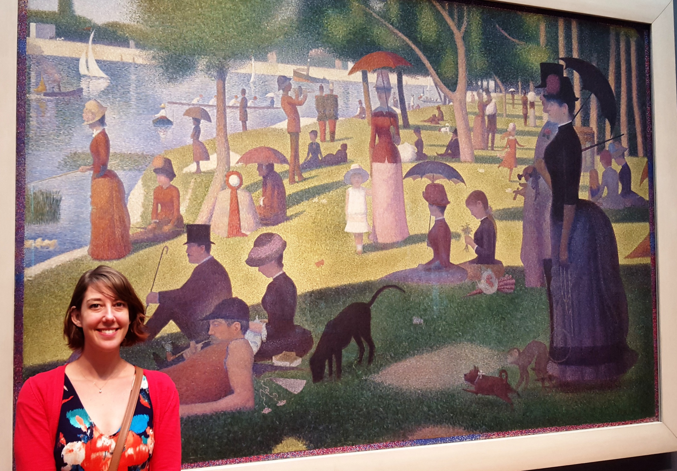

Slide 5
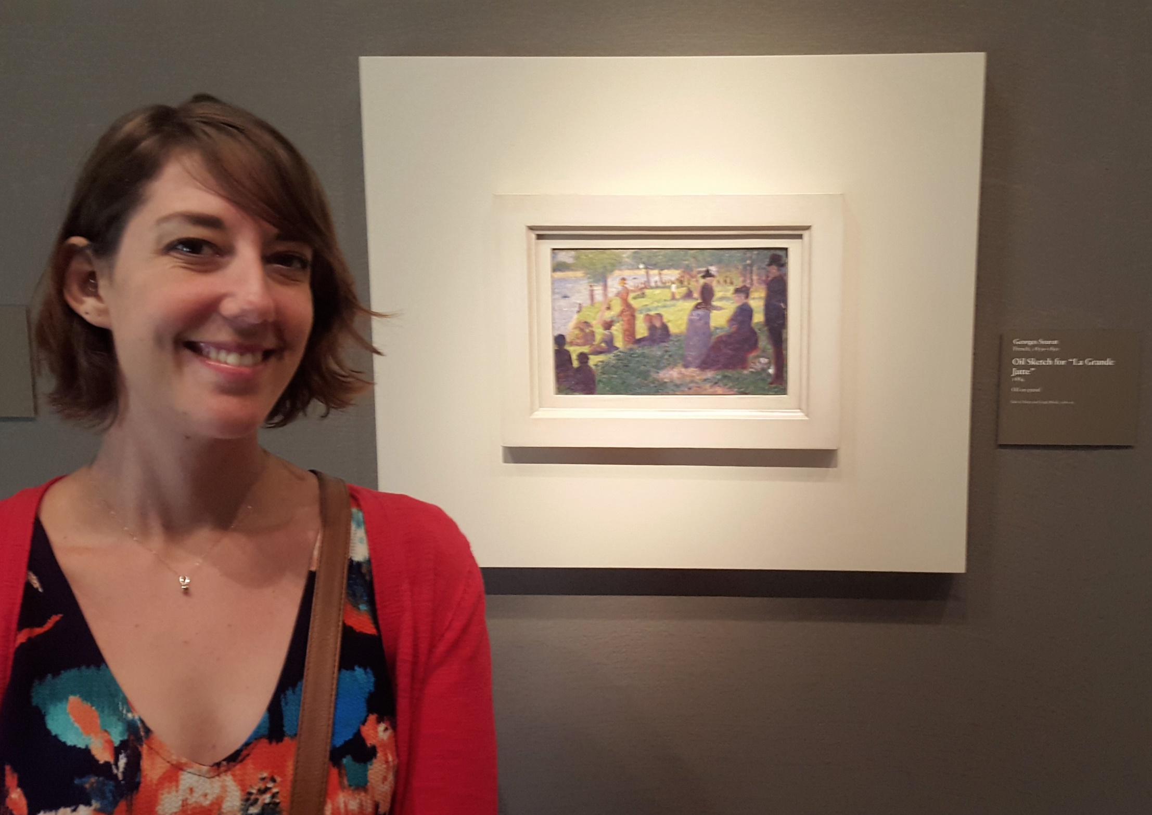

Slide 6
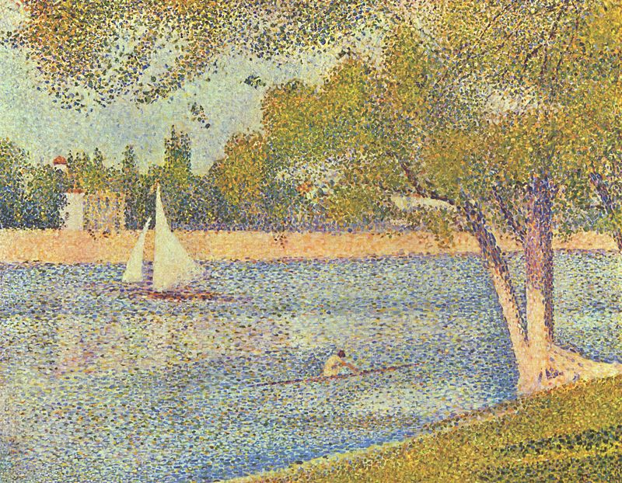
Seurat only made a few big paintings in his life. He died when he was 31-years-old.

Slide 7
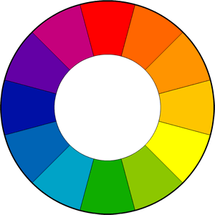
The Color Wheel!

Slide 8
COLOR SCHEMES
PRIMARY COLORS
SECONDARY COLORS
Primary means first
3 most basic colors
When mixed together, they can make any other color
RED
YELLOW
BLUE
Secondary means “second”
Made by mixing two of the primary colors together
PURPLE
GREEN
ORANGE

Slide 9
COLOR SCHEMES
TERTIARY COLORS
TINTS & SHADES
Tertiary means “third”
Made by mixing one primary and one secondary color together
RED-VIOLET
RED-ORANGE
YELLOW-ORANGE
YELLOW-GREEN
BLUE-GREEN
BLUE-VIOLET
Shade: Adding black to any color to make it darker
Tint: Adding white to any color to make it lighter
Examples:
Pink is a tint of red
Navy blue is a shade of blue

