Slide 1
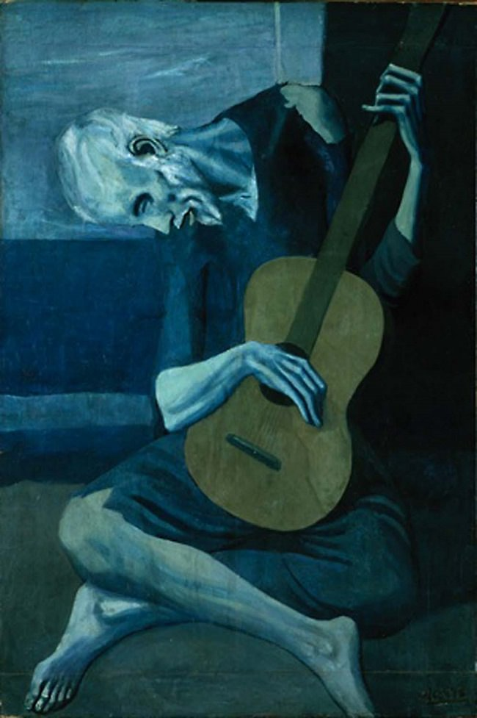
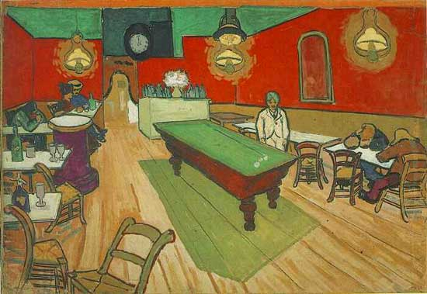
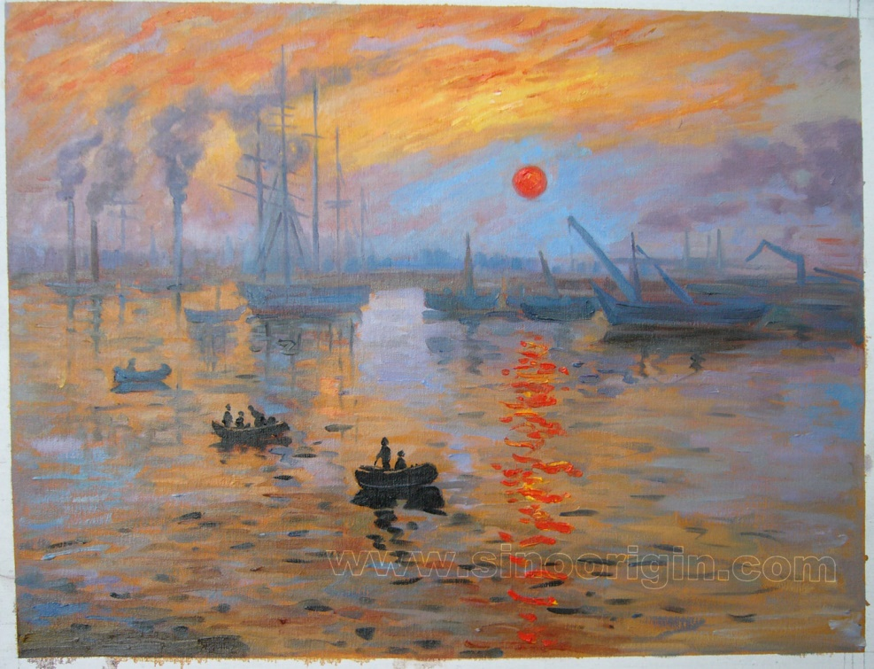
How Do Artists Use Color?

Slide 2
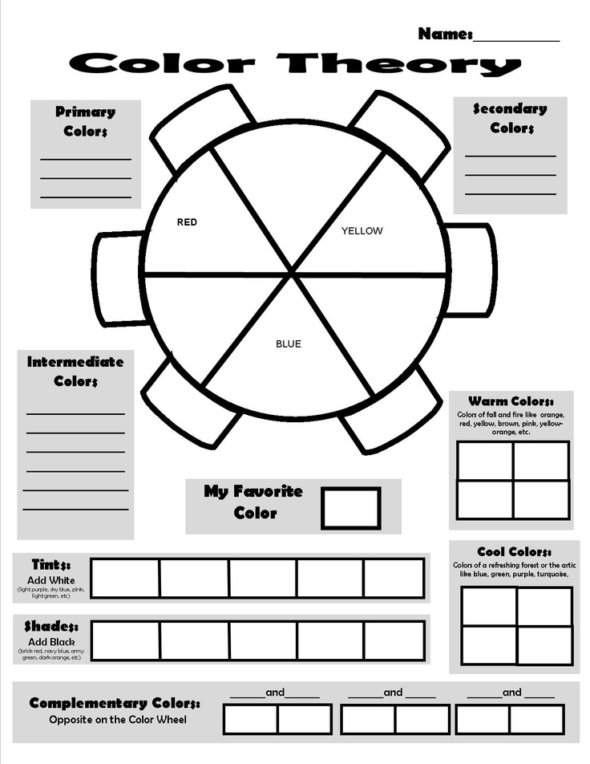
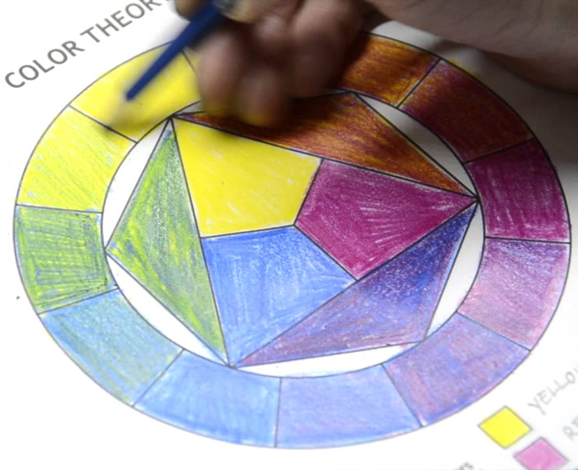
Today, we’ll practice mixing colors to understand different COLOR SCHEMES. Unlike our previous practice with colored pencils, we’ll be practicing with paint! Complete the worksheet by writing on the lines and painting in the boxes.

Slide 3
We’ll be creating… INTERESTING COLOR THEORY PAINTINGS!

Slide 4
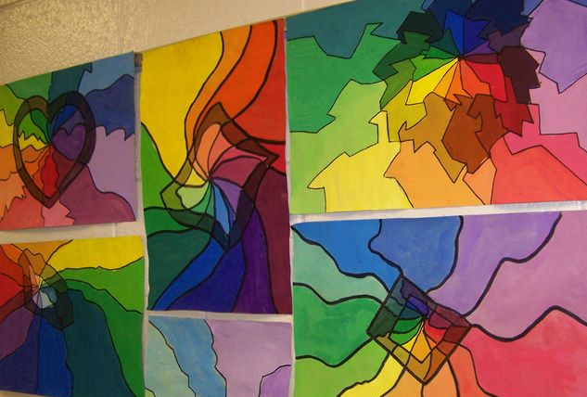
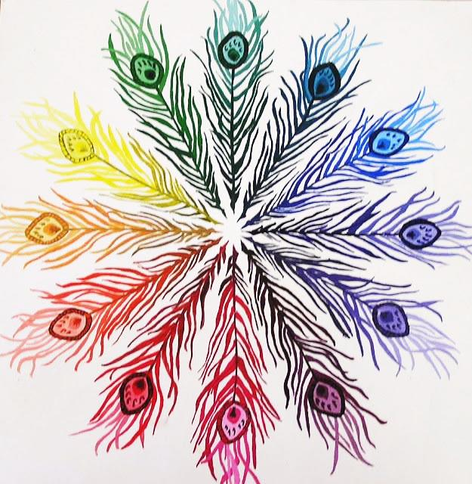
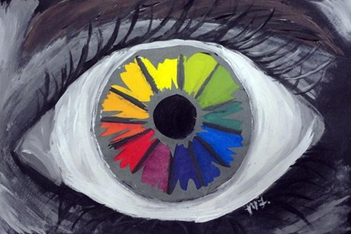

Slide 5
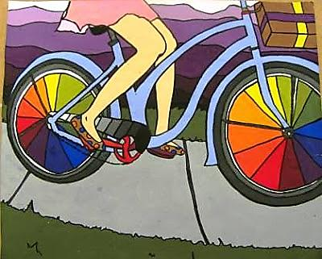
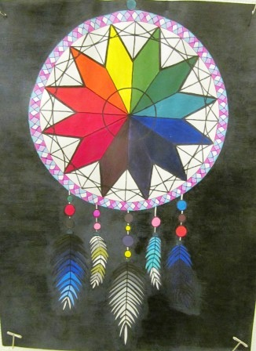
More Detailed Color Theory Paintings!

Slide 6
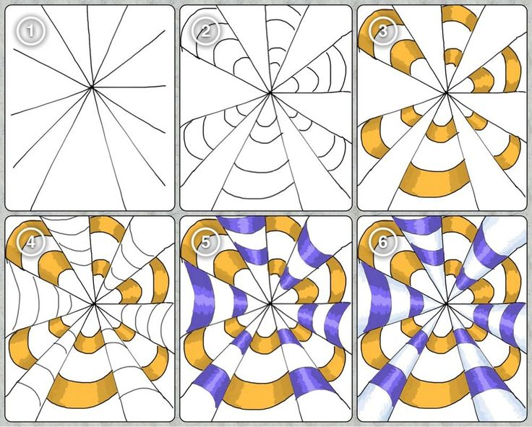
What Would You Want Your Color Wheel to Look Like?
In your SB, plan out a couple of ideas for the composition of your Color Theory Painting
Would you want it to simple or detailed? Do you want just a color wheel or do you want recognizable shapes as well?
Do you want your painting to have symmetry?
How will you show tints and shades?
Make a planning page in your SB: Draw a practice sketch of what you want your painting to look like!
Mrs. Reed will be using this composition
as her inspiration for this project

