Slide 1
Color Psychology Photo Sculptures!

Slide 2
Color Psychology

Slide 4
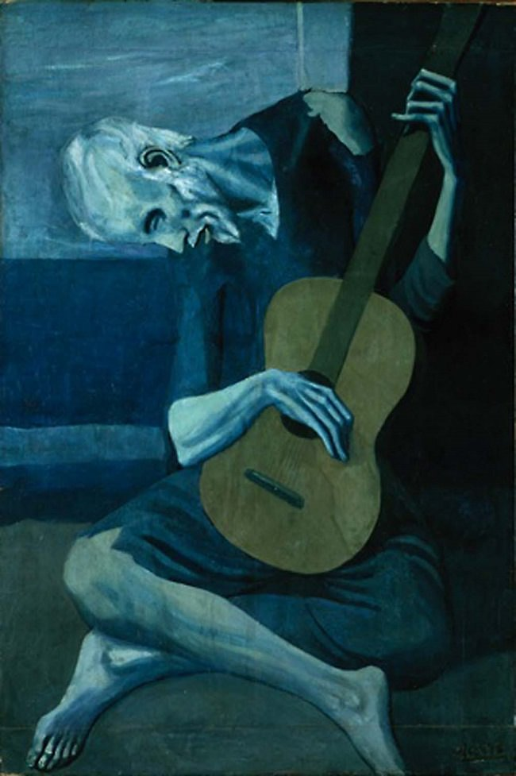
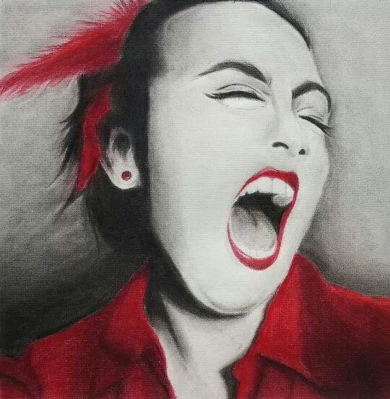
Artists have been using COLOR to show EMOTION for a very long time!
Pablo Picasso
High School Student

Slide 5
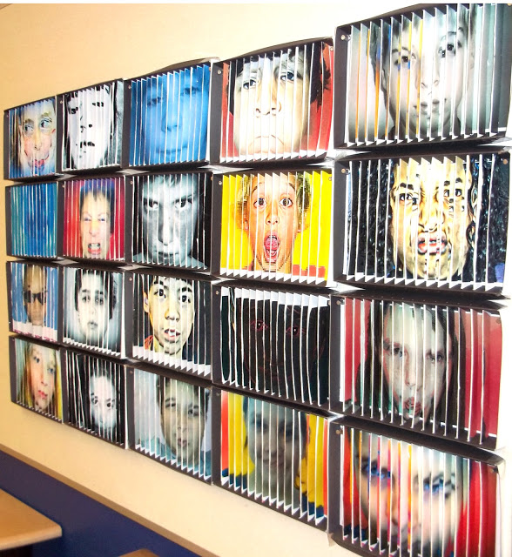

Slide 6
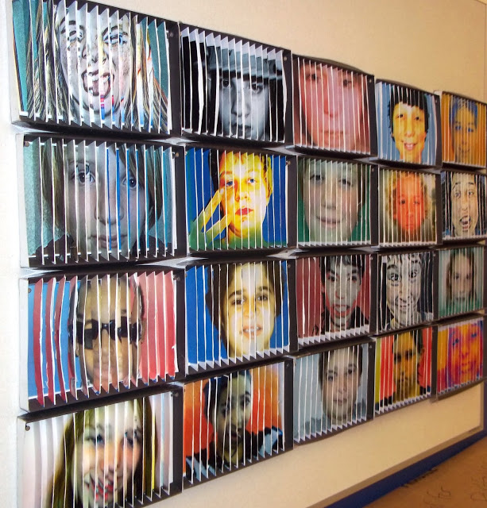

Slide 7
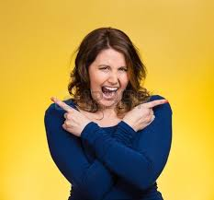
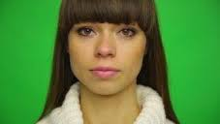
In your SB, plan out what TWO EMOTIONS you want to convey with your two SELF-PORTRAITS. How will you pose? What colors will you choose for your background? Will you be using props?

Slide 8
Photography Tips
Practice using The Rule of Thirds
Make sure you zoom in close. We should only see the person’s face and any necessary props in the photo.
The color needs to take up the whole entire background.
Experiment! Take lots of pictures and then choose the best one in the bunch.
Make sure your photos are in focus and not blurry

Slide 9
Photo-Editing Tips
Use the app Photo Editor Pro (by Zentertainment) or the website ribbet.com to edit your photos. Now it’s time to get creative!
Easy ways to enhance your photo are by changing the filter/effect and brightness
Extreme contrast and saturation will make your photo feel more dramatic
Crop to zoom in or cut off extra parts of a photo
Vignette, blur, and splash are some extra ways to REALLY get creative!
MOST IMPORTANTLY, make sure your edits HELP your photo express your chosen emotion or message. Don’t just choose whichever edits look the coolest. Can I guess your emotion by looking at your photo?
Photos need to be e-mailed to nreed@pps.net so I can print them for next week.

