Slide 1
Welcome to Art!
SB #1
Grab your sketchbook from your bin
Today, we will FREE DRAW for 10 minutes! This means you can draw whatever your heart desires (as long as it’s appropriate for school!)
Try to fill one whole page, instead of having small, unfinished drawings on multiple pages.
If you have no idea what to draw, here are some ideas:
Draw a futuristic city
Draw about a strange dream you had
Draw your favorite people
Draw yourself at your dream job
Draw about the best part of your week
Be an architect and design your dream house
Be a fashion designer and design clothes

Slide 2
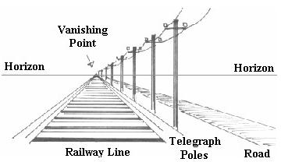
Welcome to Art!
SB #2
Grab your sketchbook from your bin
Today, we will practice drawing with One-Point Perspective! The worksheet shows you the correct order of steps to setting up a one- point perspective drawing. You’ll need a ruler too!
Important vocabulary:
Horizon Line: horizontal line where the sky meets the ground. For an indoor picture, it’s the “eye level” line.
Vanishing Point: a dot on the horizon line where all things vanish. All your guidelines should recede to this point
TIP: Any straight lines that are NOT receding to the vanishing point should be either horizontal or vertical

Slide 3
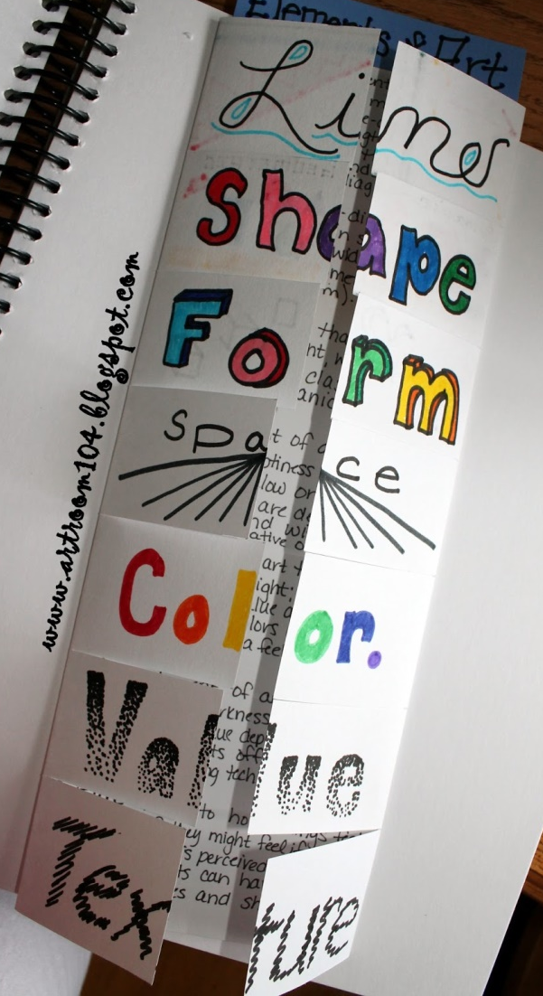
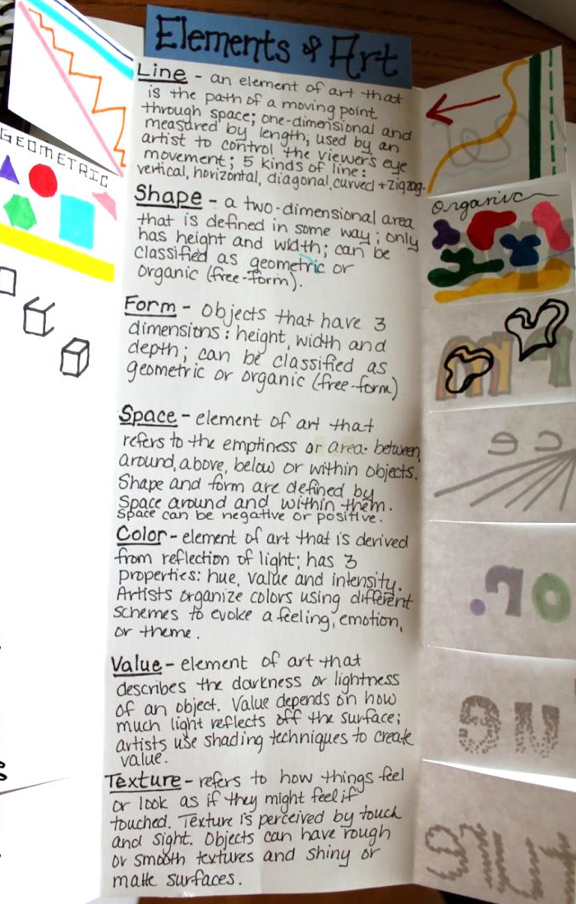
Welcome to Art!
SB #3
Grab your sketchbook from your bin and tape/glue in your Elements of Art booklet
Using your knowledge from our time in art together, write a simple definition for LINE, SHAPE, and SPACE (perspective)
Include visual examples on the underside of the flaps
TIP: Complete the front if you haven’t yet

Slide 4
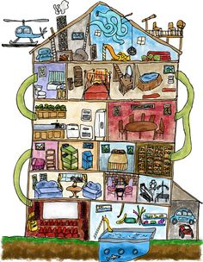
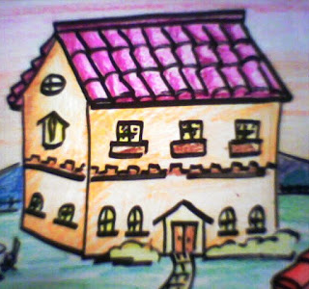
Welcome to Art!
SB #4
Grab your sketchbook from your bin and draw your perfect DREAM HOUSE!
You might choose to focus on the exterior or the interior of the house. Either is okay! You also might want to put your dream home in a really neat environment, like in a tree or on the edge of a waterfall!
TIP: The more detailed, the better!

Slide 5
Welcome to Art!
Grab your sketchbook from your bin and use today’s 15 minutes of SB time to complete any earlier SB assignments:
SB Assignment #1: Free draw! The more detailed, the better!
SB Assignment #2: One-point perspective practice. The perspective handout should be taped or glued in.
SB Assignment #3: Elements of Art pamphlet. This needs to be taped or glued into your SB and include your own definitions/visual examples for line, shape, and space (perspective) in art.
SB Assignment #4: Dream House design. Don’t be afraid to add color!
I will be grading these four assignments over the winter break, so please leave your sketchbooks here at the end of class.

