Slide 1
Welcome to Art!
SB #1
Grab your sketchbook from your bin
Today, we will FREE DRAW for 10 minutes! This means you can draw whatever your heart desires (as long as it’s appropriate for school!)
Try to fill one whole page, instead of having small, unfinished drawings on multiple pages.
If you have no idea what to draw, here are some ideas:
Draw a futuristic city
Draw about a strange dream you had
Draw your favorite people
Draw yourself at your dream job
Draw about the best part of your week
Be an architect and design your dream house
Be a fashion designer and design clothes

Slide 2
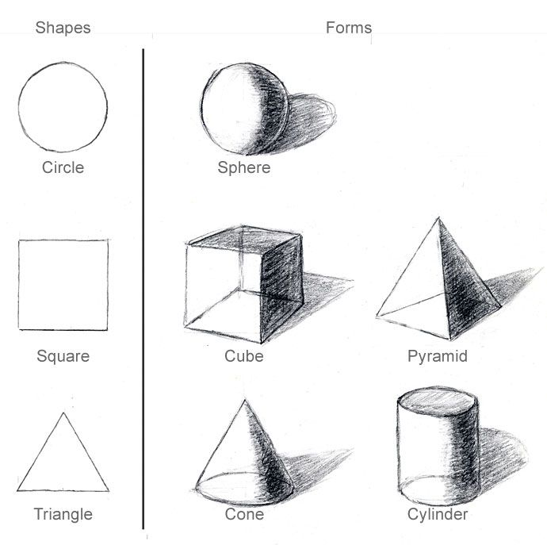
Welcome to Art!
SB #2
Grab your sketchbook from your bin
Today, we will practice drawing 3D forms! Be sure to grab the worksheet and tape/glue it into your sketchbook
In art, SHAPES are two-dimensional and flat (circle, square, triangle…)
FORMS are three-dimensional (sphere, cube, pyramid…)
TIP: Add VALUE and SHADING to make your forms look SUPER 3D!

Slide 3
Welcome to Art!
DO NOT grab your sketchbook from your bin!
We’re going to talk about how you’ll be graded for your Graffiti Collage artwork
Once complete, read over & fill out the rubric for your project. Grade yourself honestly on a scale of 1-4 for each of the 5 categories. Only fill in the column marked “YOU”
If you don’t finish today, you need to complete it over the weekend. It’s due Monday.

Slide 4
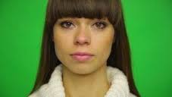
SB #3
Create a planning page for your Color Psychology photographs.
What 2 emotions do you want to convey or express? What would be the best color background to match those 2 emotions?
How are you going to pose? What facial expression will you have? Will you be using props?
Remember, you will need TWO PORTRAITS with two different colors and emotions (example: blue & sad, orange & cheerful)

Slide 5
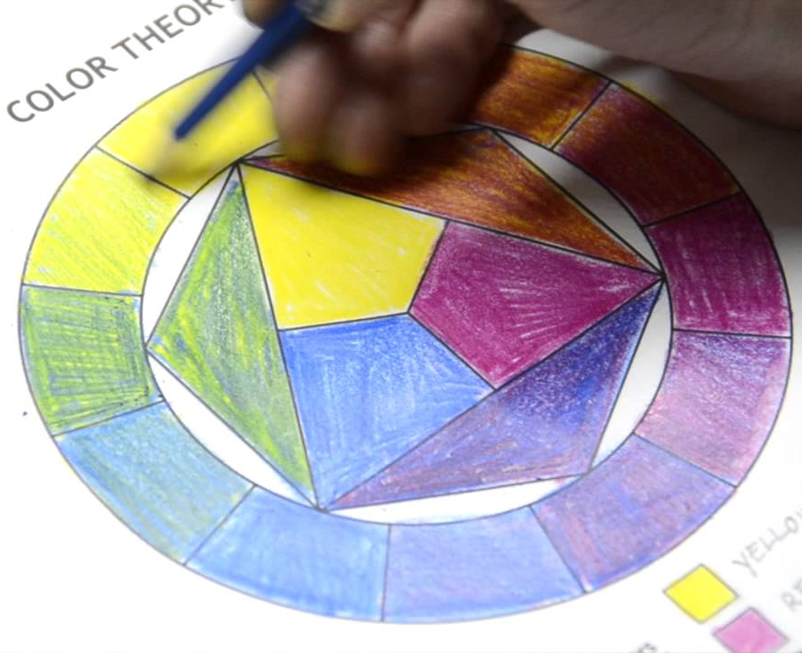
Welcome to Art!
SB #4
Grab your sketchbook from your bin and glue/tape in today’s worksheet.
Today, we practice color mixing on a color wheel!
Using colored pencils or crayons, fill in the color wheel in this order:
Start with the primary colors (red, yellow, blue) first
Mix these colors to create secondary colors (orange, green, violet)
Mix one primary and one secondary to create a tertiary color (red-violet, blue-green, etc.)

Slide 6
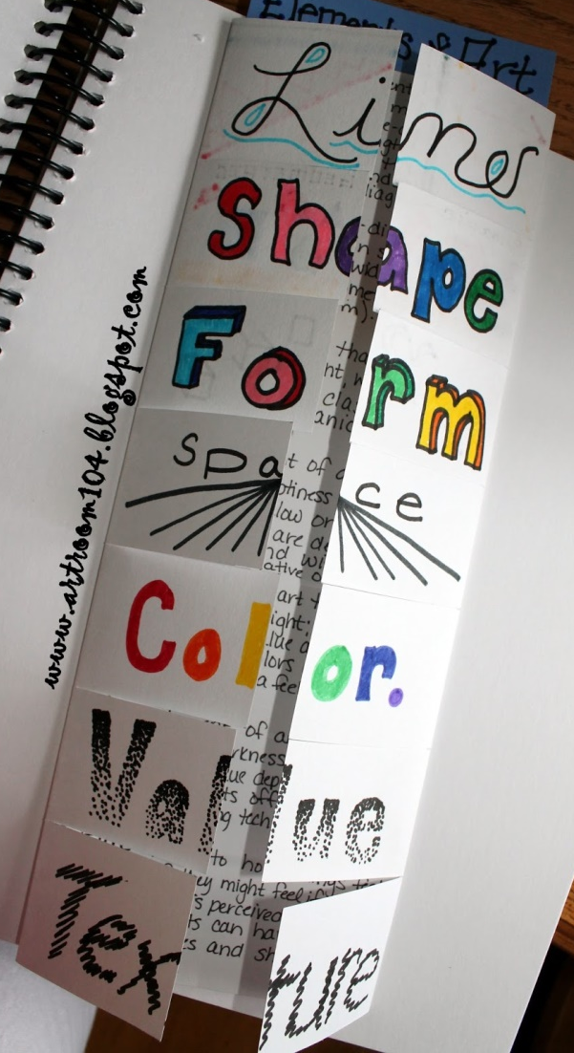
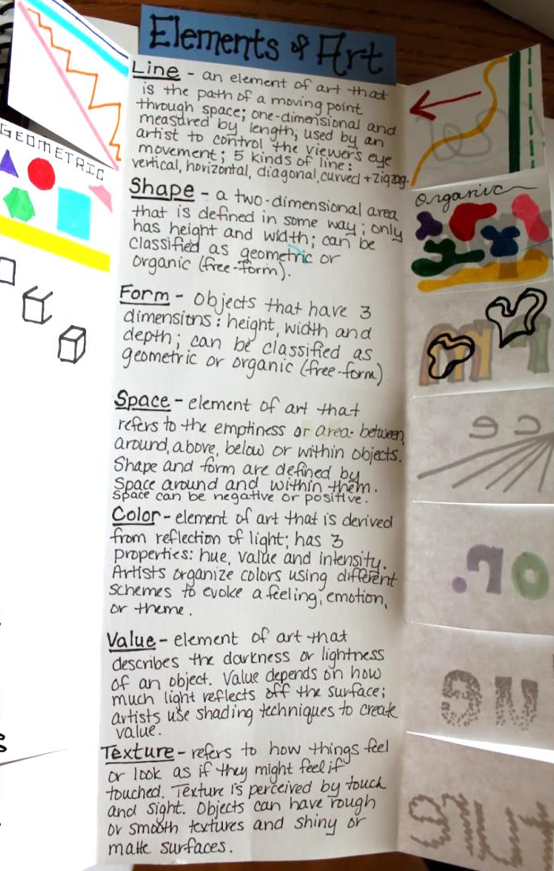
Welcome to Art!
SB #5
Grab your sketchbook from your bin and tape/glue in your Elements of Art booklet
Using your knowledge from our time in art together, write a simple definition for VALUE, SHAPE/FORM, and SPACE (COMPOSITION)
Include visual examples on the underside of the flaps
TIP: Complete the front if you haven’t yet

Slide 7
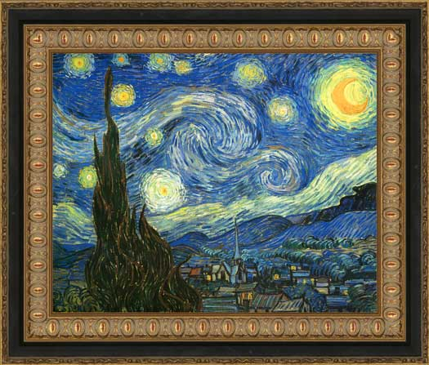
Welcome to Art!
SB #6
Today, you will be writing an Artist’s Statement about your latest work of art!
Fill out the worksheet and try to be SPECIFIC and HONEST when talking about your artwork.
It’s important for an artist to reflect, so that you can learn from your mistakes and improve in the future.
Make sure this is taped or glued onto the next clean page in your sketchbook.

Slide 8
Welcome to Art!
DO NOT grab your sketchbook from your bin!
We’re going to go over directions for our next project. Listen closely!

