Slide 1
Welcome to Art!
SB #1
Grab your sketchbook from your bin
Today, we will FREE DRAW for 10 minutes! This means you can draw whatever your heart desires (as long as it’s appropriate for school!)
Try to fill one whole page, instead of having small, unfinished drawings on multiple pages.
If you have no idea what to draw, here are some ideas:
Draw a futuristic city
Draw about a strange dream you had
Draw your favorite people
Draw yourself at your dream job
Draw about the best part of your week
Be an architect and design your dream house
Be a fashion designer and design clothes

Slide 2
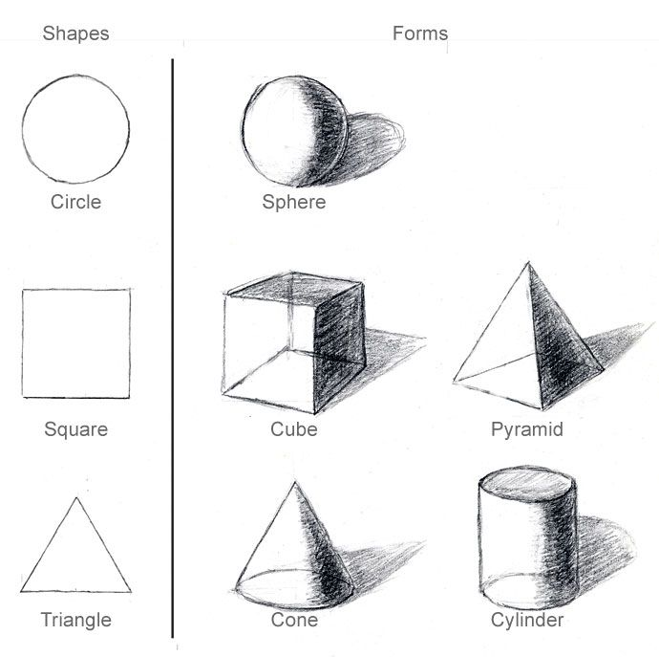
Welcome to Art!
SB #2
Grab your sketchbook from your bin
Today, we will practice drawing 3D forms! Be sure to grab the worksheet and tape/glue it into your sketchbook
In art, SHAPES are two-dimensional and flat (circle, square, triangle…)
FORMS are three-dimensional (sphere, cube, pyramid…)
TIP: Add VALUE and SHADING to make your forms look SUPER 3D!

Slide 3
Welcome to Art!
DO NOT grab your sketchbook from your bin!
Read over and fill out the rubric for your project. Grade yourself honestly on a scale of 1-4 for each of the 5 categories. Only fill in the column marked “YOU”
You have 15 minutes to complete.
If you finish early, you may grab your sketchbook and free draw until time is called.

Slide 4
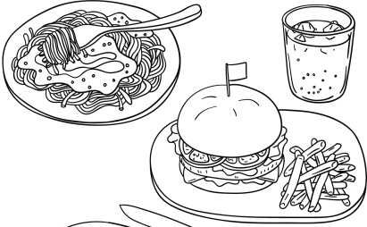
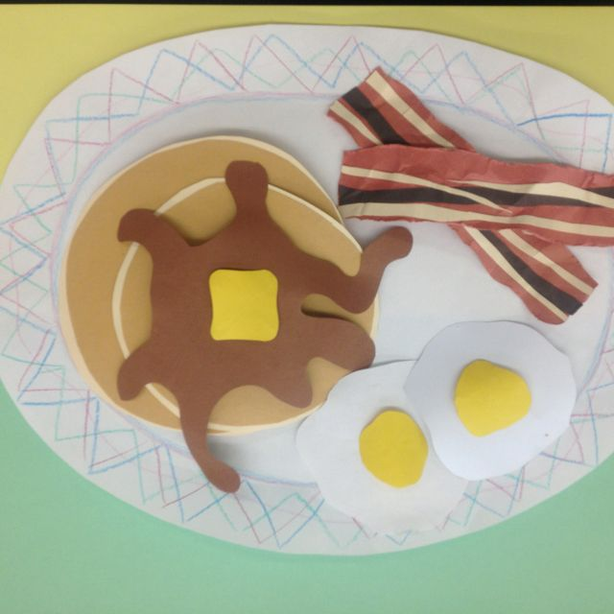
SB #3
Create a planning page for your Textured Food Collage project.
What shapes will you need to cut out for the different parts of your food?
Which colors of paper will you need?
What will the background of your food look like? Will you have plates, bowls, utensils, napkins, placemats, cups, or anything else?
What are some ways you can show different textures in your collage, using only paper?

Slide 5
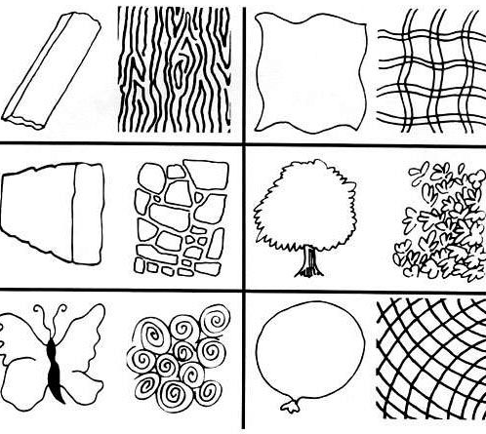
Welcome to Art!
SB #4
Grab your sketchbook from your bin
Today, we will practice drawing IMPLIED TEXTURES
Grab the worksheet for neat ideas on how to show texture in your artwork!
Start thinking…how you could show texture in your food collage?

Slide 6
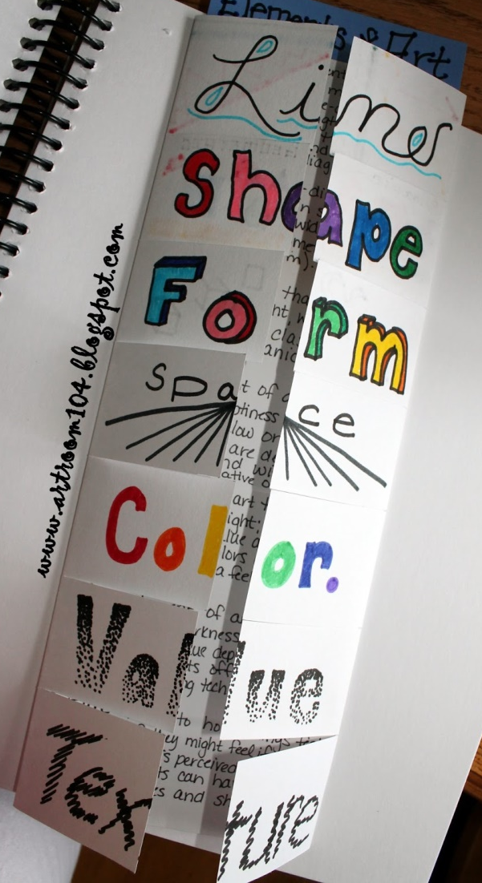
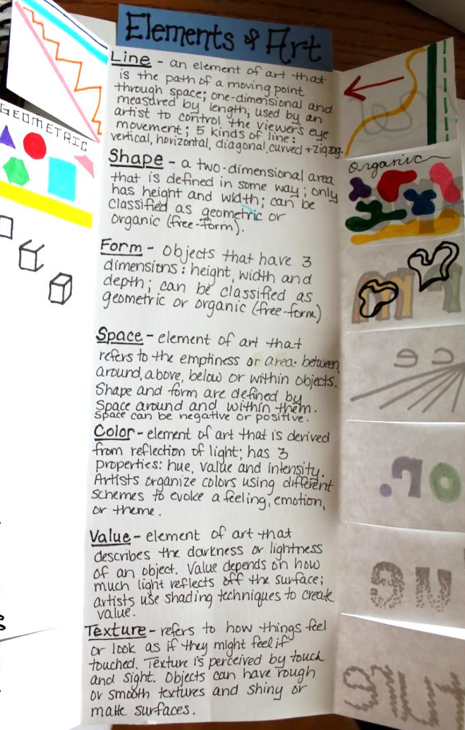
Welcome to Art!
SB #5
Grab your sketchbook from your bin and tape/glue in your Elements of Art booklet
Using your knowledge from our time in art together, write a simple definition for LINE, SHAPE/FORM, SPACE (COMPOSITION), and TEXTURE
Include visual examples on the underside of the flaps
TIP: Complete the front if you haven’t yet

Slide 7
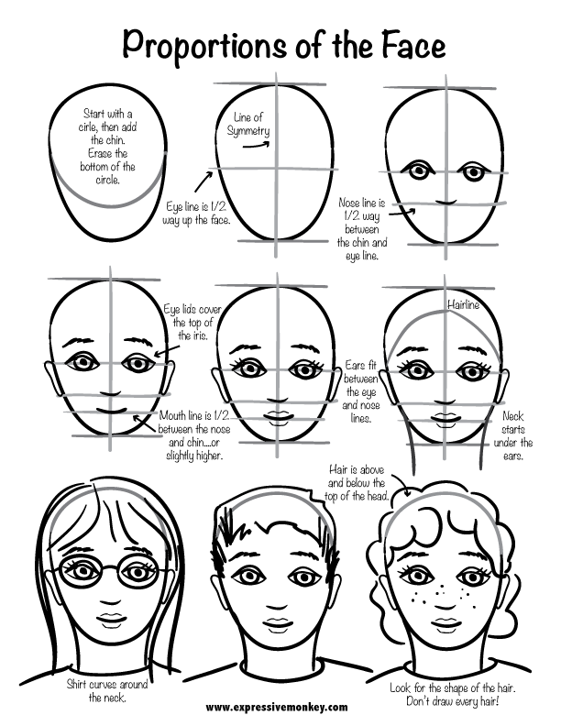
Welcome to Art!
SB #6
Grab your sketchbook from your bin and glue/tape in today’s worksheet.
Today, we will practice drawing portraits! You can draw any person you’d like.
TIP: draw your guidelines lightly so they’ll be easy to erase.
Follow the step-by-step directions on the worksheet so you have the correct proportions and placement for the eyes, nose, mouth, and ears.

Slide 8
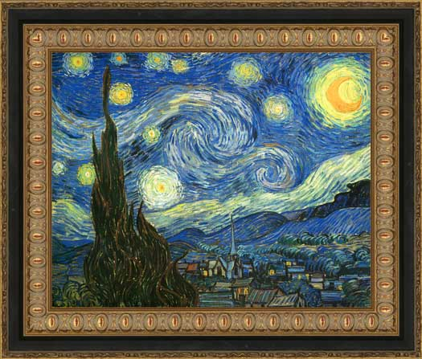
Welcome to Art!
SB #7
Today, you will be writing an Artist’s Statement about your latest work of art!
Fill out the worksheet and try to be SPECIFIC and HONEST when talking about your artwork.
It’s important for an artist to reflect, so that you can learn from your mistakes and improve in the future.
Make sure this is taped or glued onto the next clean page in your sketchbook.

Slide 9
Welcome to Art!
DO NOT grab your sketchbook from your bin!
We’re going to go over directions for our next project. Listen closely!

Slide 10
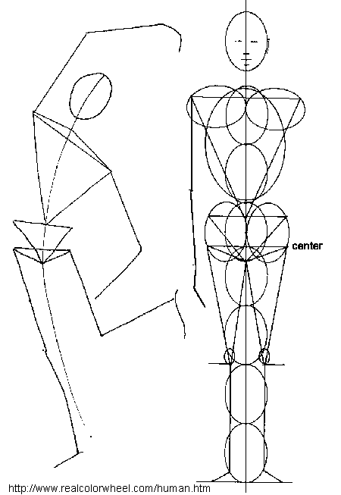
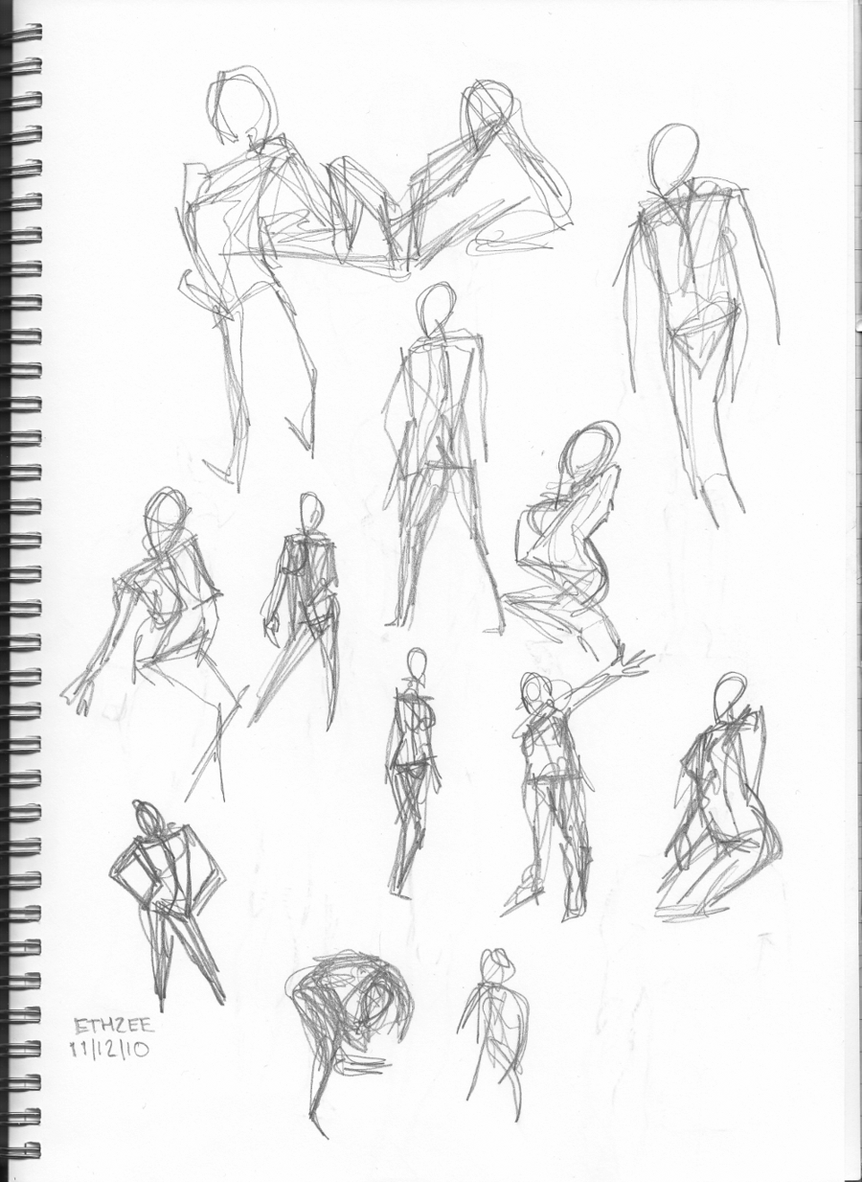
SB #8
Complete several in-class Gesture Drawings of your classmates’ poses
Gesture Drawing is a QUICK drawing that captures the action, movement, and structure of a figure, rather than showing specific details.
Think about the proportions of the human body and where the joints are

